Slide 1


Duration: 65 min
Grades: 9 - 12
High School
Group hand-in 4
7313 - Data Science Analytics 2021
Group 3: Julius von Dryander, Marc Gehring, Sebastian Waeteraere, Magnus Lütt

Slide 2
Buy N Large needs to understand drivers of product returns
Business Rationale
Situation
Complication
Solution
Choice of case
Buy N Large is a department store chain operating online and offline
One of their KPIs is related to sustainability
BNL wants to understand the drivers of product returns
Returns allow customers to make buying decisions easier
Offering returns results in a competitive advantage for companies
Offering returns poses a business challenge for Buy N Large
Negative impact on the bottom line (expensive and logistically challenging)
Returns lead to higher waste, which drives up costs and impacts Buy N Large's environmental footprint
Returns cannot be abolished as industry standard (hygiene factor)
Analyze data on product and transaction level to understand the drivers of product returns
Fit and evaluate machine learning models that help BnL to understand drivers of product returns
Use the insights to adapt the product portfolio, logistics, and marketing
Minimize the impact on the company’s triple bottom line
Machine Learning Model
We utilized an extensive data set provided by Buy N Large to fit and evaluate machine learning models that help to understand drivers of product returns. The data set contains 620,274 transactions and 28,034 different items.
Response variable: Product returns (is_returned)
Predictors: avg_amount, avg_discount, purchase location (prop_online), customer loyalty (prop_loyalcust), season (xmas_prop), weekday (wkd_prop), sustainability category (label)

Slide 3
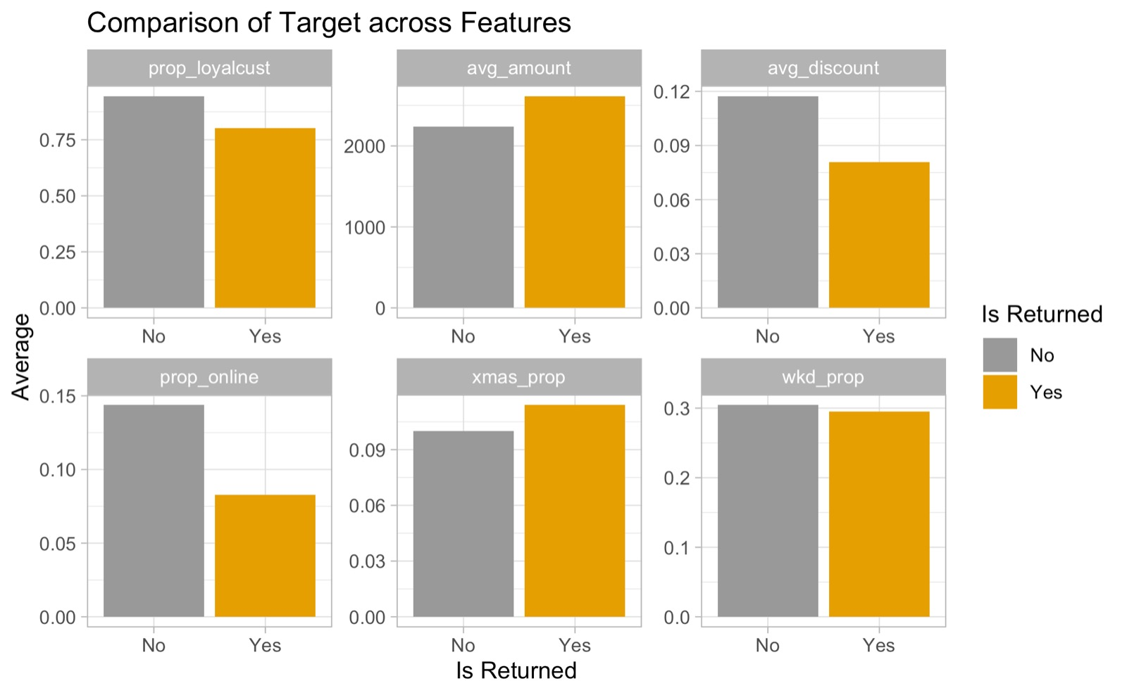
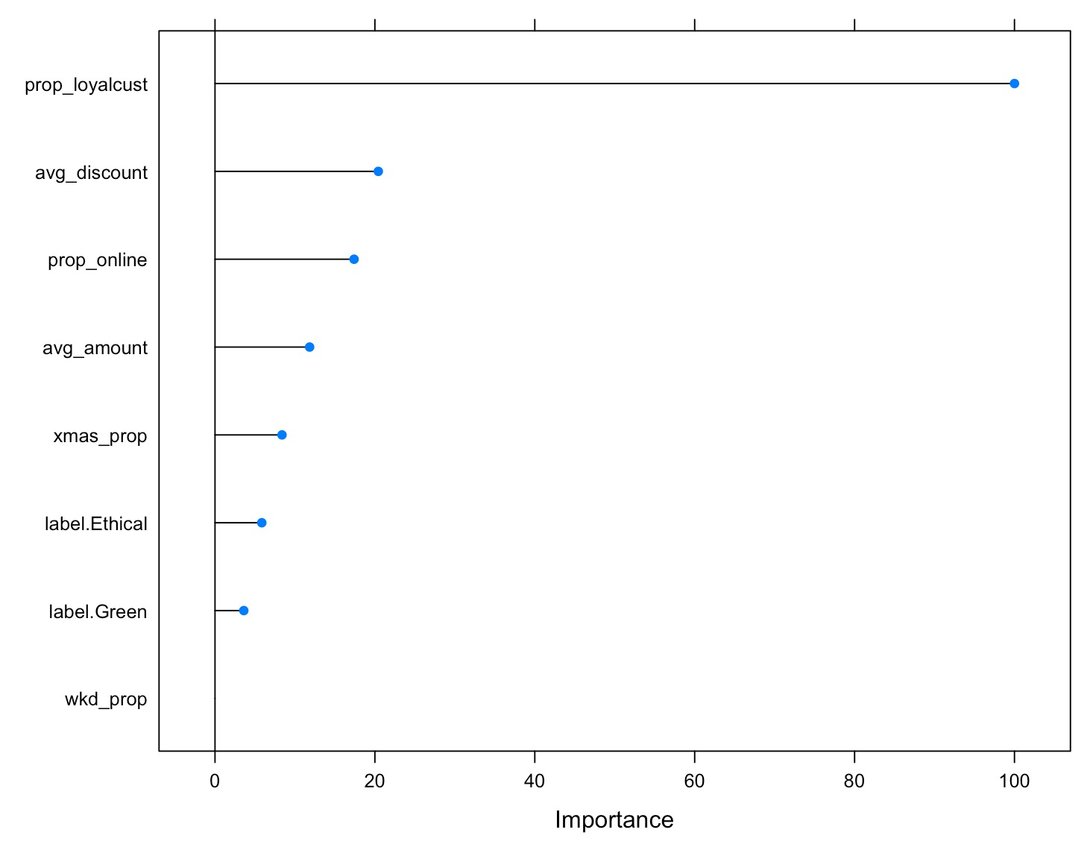
Data
At item level, features were identified that drive product returns
Preliminary results: feature comparison
Modelling results: product return drivers
Preliminary results on the expected drivers of product returns can be obtained prior to the actual modelling via descriptive statistics
Barplots for every feature, comparing the target variable (is_returned) and the average of the respective feature, provide a first indication
Prob_online and avg_discount seem to have the greatest relative difference between returned and non-returned items
The results indicate that across all variables, customer loyalty (prop_loyalcust), average discount (avg_discount), purchase location (prop_online), season (xmas_prop) and the label (label.Ethical) are the most important variables
Importance here means that these variables play the biggest role in enhancing model accuracy

Slide 4
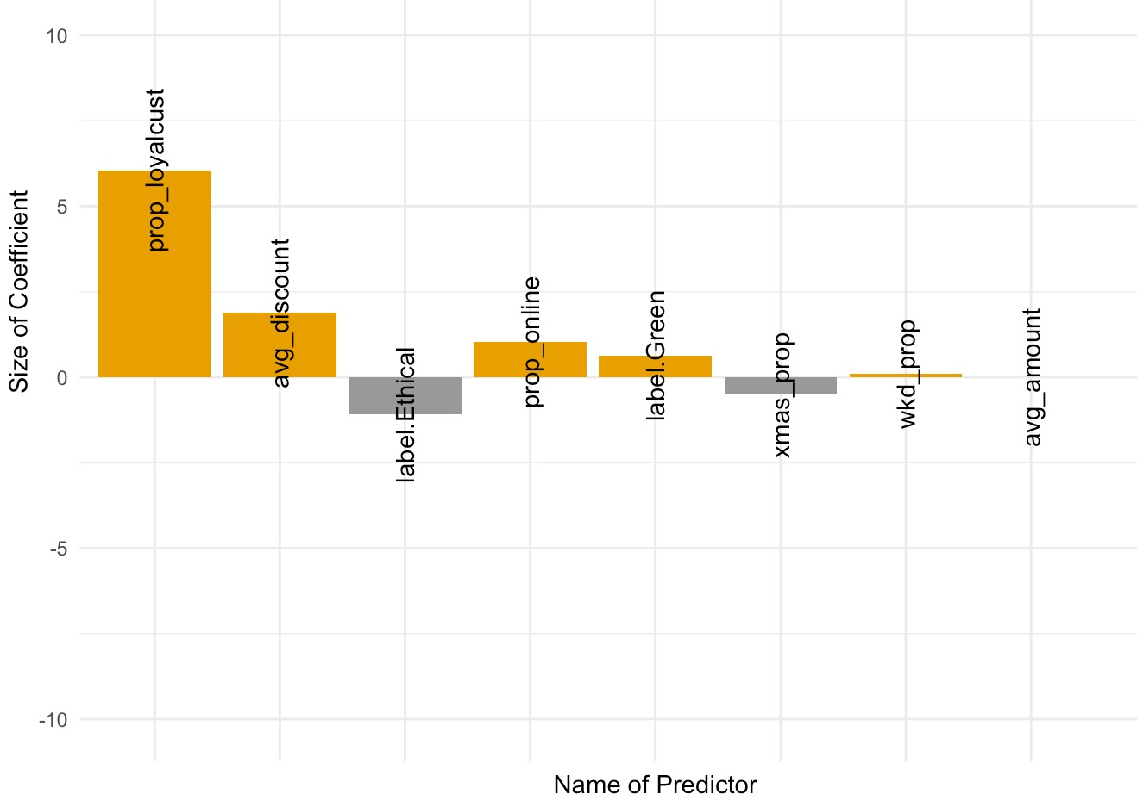

Buy N Large should incentivize loyal customers to reduce product returns to positively impact the triple bottom line
Question 2
Recommendations
Model Implications
Business Actions
PPP Impact
Choice of case
Return driving predictors from logistic regression
Higher profits via cost reduction in logistics and personnel in return management
Create incentives for loyal customers to reduce returns
Sell higher proportion of ethical labelled products
Optimize online offering to avoid/ reduce product returns due to poor/inaccurate information (better recommendations, size guidance)
Inform online buyers about the negative environmental impact of returns (Nudging)
Reduce offering of discounted articles
Offer free delivery for items purchased online but charge customers for return logistics
Less environmental impact via waste reduction
Wider range of ethically labelled products
A logistic regression has been used to determine the size of coefficients:
Increased customer satisfaction with optimized product offering
Better informed customers with ethical labels
Return drivers
Prop_loyalcust
Avg_discount
Prop_online
Retain drivers
label_Ethical
Xmas_prop

